Slide 1
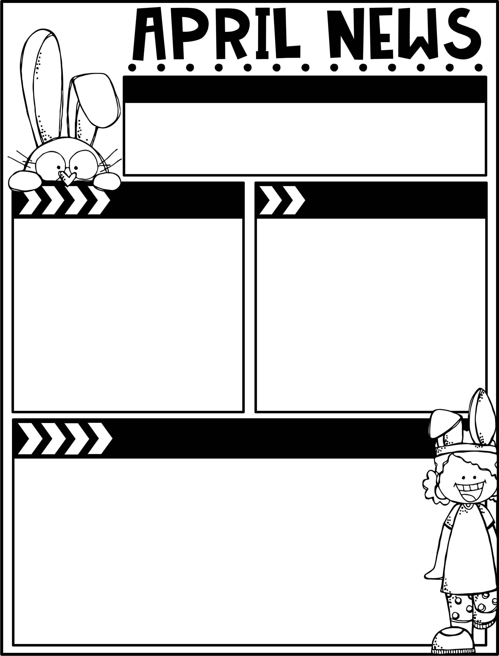
April 11, 2025
The Moreau Heights family is committed to providing a positive and safe learning environment to support responsible and productive citizens.
Phone:
573-659-3180
Plan Time:
1:35-2:25 pm
Emails:
mason.johnson@jcschools.us
danielle.mcgeorge@jcschools.us
theresa.schell@jcschools.us
Calendar
Learning Targets
M 04/14 C Day
T 04/15 A Day
W 04/16 B Day
Th 04/17 C Day
F 04/18 3 Hour Early Release
M 04/21 A Day
T 04/22 B Day
W 04/23 C Day
Th 04/24 A Day
F 04/25 B Day, Library Checkout
Reading/Writing
I can answer written multiple choice questions about key details in the text.
I can answer literal & inferential questions about key details in the text.
I can utilize text features to locate chapters and the glossary to clarify the meaning of words.
Math
I can measure an object twice by using different length units & compare & relate measurement to unit size.
I can measure to compare difference in lengths.
I can identify unknow numbers on a number line by using the interval as a reference point.
I can solve word problems that involve measuremtnets.
Science
I can explain why plants need light and water to grow.
Things to Know
Specials Schedule:
Library Check-Out:
Second grade has check-out on Fridays! Please help your child remember their books!
If you would like to send in
Snacks for our class that would
Be great!!!!
Please continue to read with your
Child at home!
 | Mr. J | Mrs. M | Ms. S
A | Music | PE | Art
B | PE | Art | Music
C | Art | Music | PE

